Slide 1
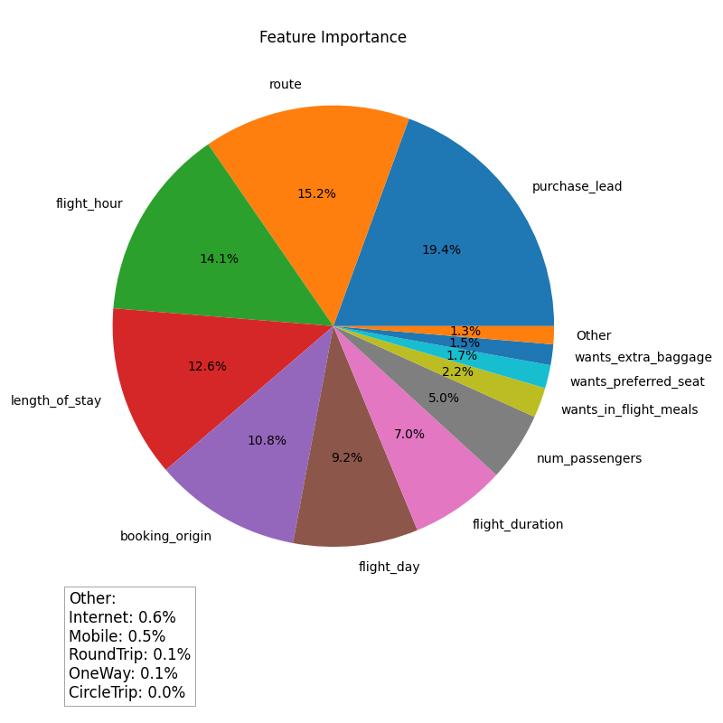

"Key Factors Impacting Customer Bookings: Feature Importance Analysis"
I developed a Random Forest Classifier AI model which achieves an impressive accuracy score of approximately 85.5%, to predict customer bookings for British Airways.
It conducts feature importance analysis to uncover the key factors that significantly influence booking decisions.
By leveraging the insights from my model, British Airways can optimize services, improve marketing efforts, and enhance the overall customer experience, leading to increased booking conversions.

